Slide 1
Ideas Laboratory "Green AI"

Slide 2
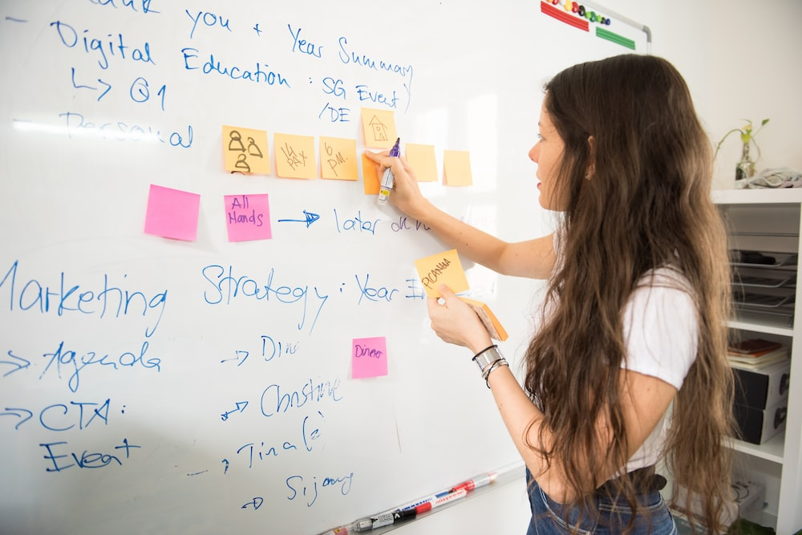
Brainstorming
Talk about the environmentally friendly measures you have collected and practical examples of environmentally friendly AI applications in your teams
Make a top 3 list and finally decide on an area or a problem for which you want to develop a program / app yourself

Slide 3
Specification
Think about what exactly the goal of your application should be and what functions it should be able to do. Write down all the points to consider.
What is the goal of your app? What exactly should she do? How can the idea work? How will you make your app appealing to your users? What do you set out to do? What problem do you want your app to help solve?

Slide 4


Design
Think of a project name, design a logo and make sketches of what the program could look like.

Slide 5
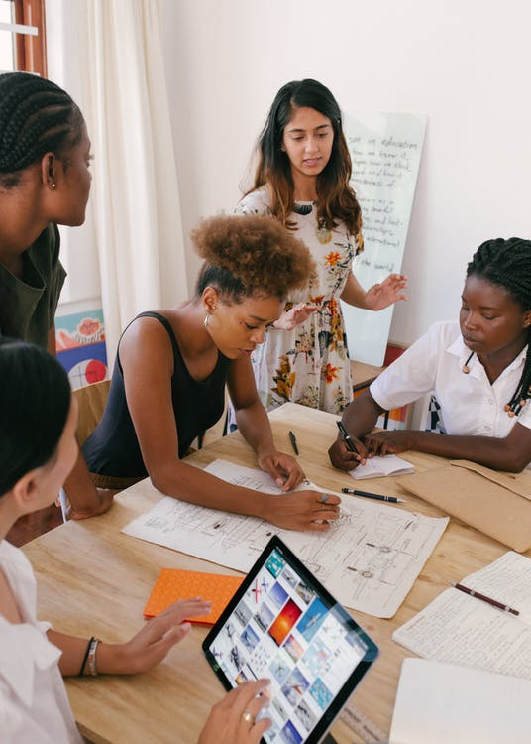
Presentation at the World Café
A group member remains at your table as a moderator.
The other group members sit down at the table of another project group for the given time
Talk about the project at the table, give feedback, ask questions, make sketches and suggestions on the papers

Slide 6
Overwork
Discuss the collected feedback for your project and consider which of the suggestions you want to include in your project and how.

Slide 7

Final presentation
Choose one or two speakers and present your projects in plenary
Explain your idea, where there were difficulties, which feedback you included and which you did not include (also why you did not include some things).

